Slide 1
Agenda Cisco Data Virtualization PDTool Training
Notes:
Hello, and welcome to the Basic Training course for Cisco Information Server, or CIS. In this first video, we’ll look at the agenda of our four-day training course.

Slide 2
Agenda
x

Slide 3
PDTool
Topic

Slide 4
Agenda – Day 1
Create a SQL View
Product Overview
Installation
Using the Grid Panel
Connecting to a Data Source
Publishing Resources
Introspection
Notes:
Day 1 of CIS training includes seven main topics. We begin with an overview of the product. Next, we cover installation of CIS as well as the CIS Development Studio. Our third module teaches how to connect to a data source. We then look at introspection of data sources. Next, we learn to create a federated SQL view of data. We then examine the Grid Panel in the Development Studio. We end Day 1 by learning to publish resources for external consumers.

Slide 5
Course Labs
Installation
Connect to CSV File
Creating a Simple View
Creating Joins and using the Grid Panel
Publishing Views as a Database
Publishing Views as a Web Service
Procedures: SQL Script
Procedures: Parameterized Queries
Procedures: Packaged Queries
Notes:
A number of Lab activities are interspersed throughout the course. Labs instruction documents are included as companion documents to these course videos. These labs will provide hands-on experience with a wide range of CIS development activities, including: Installation, Connecting to a CSV file, Creating a simple view, Creating Joins and using the Grid Panel, Publishing views as a database, Publishing views as a web service, SQL Script procedures, Parameterized Queries, and Packaged Queries.

Slide 6
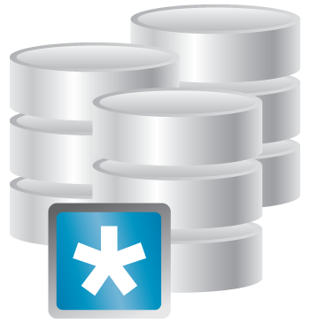









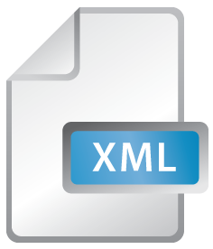




Relational
Data Warehouse
Packaged App
Big Data
Hierarchal
HTML
Web Services
Word
Excel
HTML
XML
File
Flat File
Tablet
Smart Phone

Slide 7


















BI Tools
Excel
Web Portal
Enterprise Search
Relational Views
Spreadsheet
Virtual Mart/ODS
Cache
Services

